Slide 1
Internal models within Non-life insurance
Olov Dahlberg & Johan Bergström

Slide 2
agenda
Who are we?
Introduction
Modelling one risk at a time
Modelling through a cash flow approach
Excel Example

Slide 3
Who are we?
… and the short story about Trygg-Hansa

Slide 4
Seemingly random Numbers
41
13, 10, 9, 0
33
15
11
6
1

Slide 5
introduction
5

Slide 6
Reserving at trygg-hansa
Homeowners
’All’ non-life line of businesses
Methods for IBNR reserving
Other reserves
Reporting …. Traffic Light →
PA
Motor
Care
Commercial (non-motor)
Chain-Ladder
Naive loss ratio method
Born-huetter fergusson
Annuities
UPR
URR
SE GAAP
UK GAAP
Discounting
DK GAAP
6

Slide 7
what about sII Technical Provisions?
We have delivered SII technical provisions for some years now…
…. several of above features are used in Traffic Light reporting
7

Slide 8
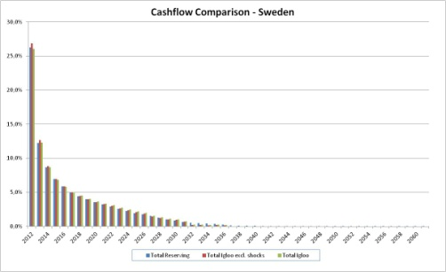
Reserving and Internal model … for solvency requierement
Technical Provisions
Internal Model
Paid Triangle
Mean Cash Flow
Cashflow with volatility
Reserve CoV
+ case reserves
Incurred Triangle
Case + IBNR
Chain ladder, B-F method
8

Slide 9
Solvency capital requirement (SCR)
Article 101 (3):
The Value-at-Risk of the basic own funds of an insurance or reinsurance undertaking subject to a confidence level of 99,5% over a one-year period.
9

Slide 10
From opening balance to closing balance
Reserve Risk
Operational Risk
Credit Risk
UW Risk
Catastrophe Risk
Market Risk
10

Slide 11
From opening balance to closing balance
11

Slide 12
Solvency capital requirement (SCR)
SCR:
Opening Own Funds – Closing Own Funds(99,5th)
11 319 - 2 923 = 8 396

Slide 13
One risk at a time approach
13

Slide 14
One risk at a time
Reserve Risk
UW Risk
Catastrophe Risk
Credit Risk
Market Risk
Change in BOF
Copula:
SCR
14

Slide 15
Cash flow approach
15

Slide 16
igloo
16

Slide 17
Cash flow approach
Reserve Risk
UW Risk
Catastrophe Risk
Credit Risk
Market Risk
Change in BOF
Dependent through cash flow
17

Slide 18
Questions?

